Slide 1
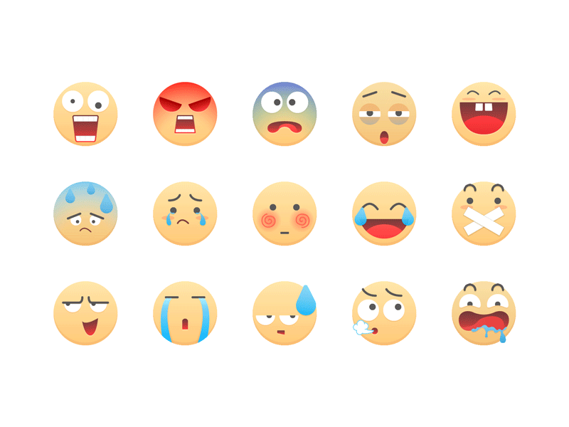
Are you happy today?

Slide 2
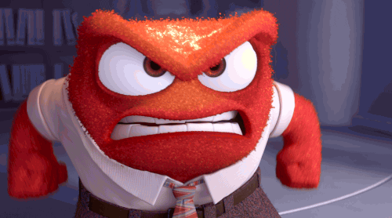
angry
mad
piss off
hit the ceiling

Slide 3
I am angry.

Slide 4
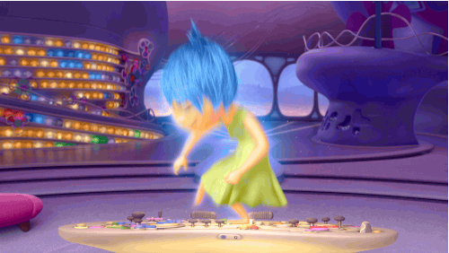
happy
glad
joyful
over the moon

Slide 5
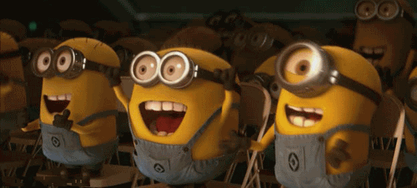
They are happy.

Slide 6
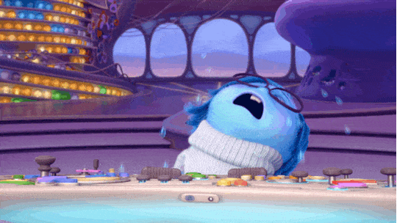
sad
down
blue
in a bad mood

Slide 7
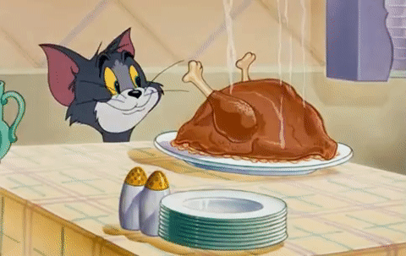
hungry
starving
I could eat a horse.

Slide 8
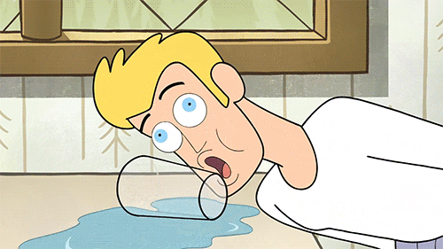
thirsty
parched
I’m drier than the desert.

Slide 9
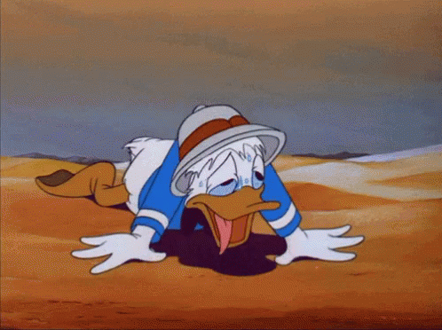
He is thirsty.

Slide 10
sick
have a cold
I'm not feeling well.

Slide 11
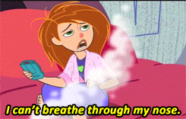
She is sick.

Slide 12
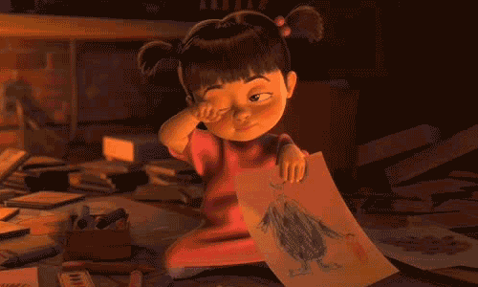
tired
sleepy
feel dog-tired

Slide 13
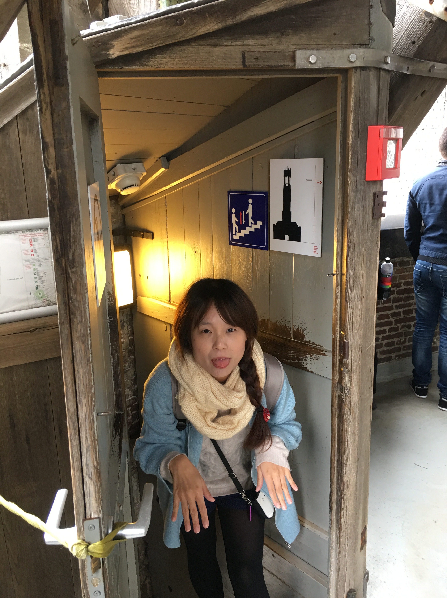
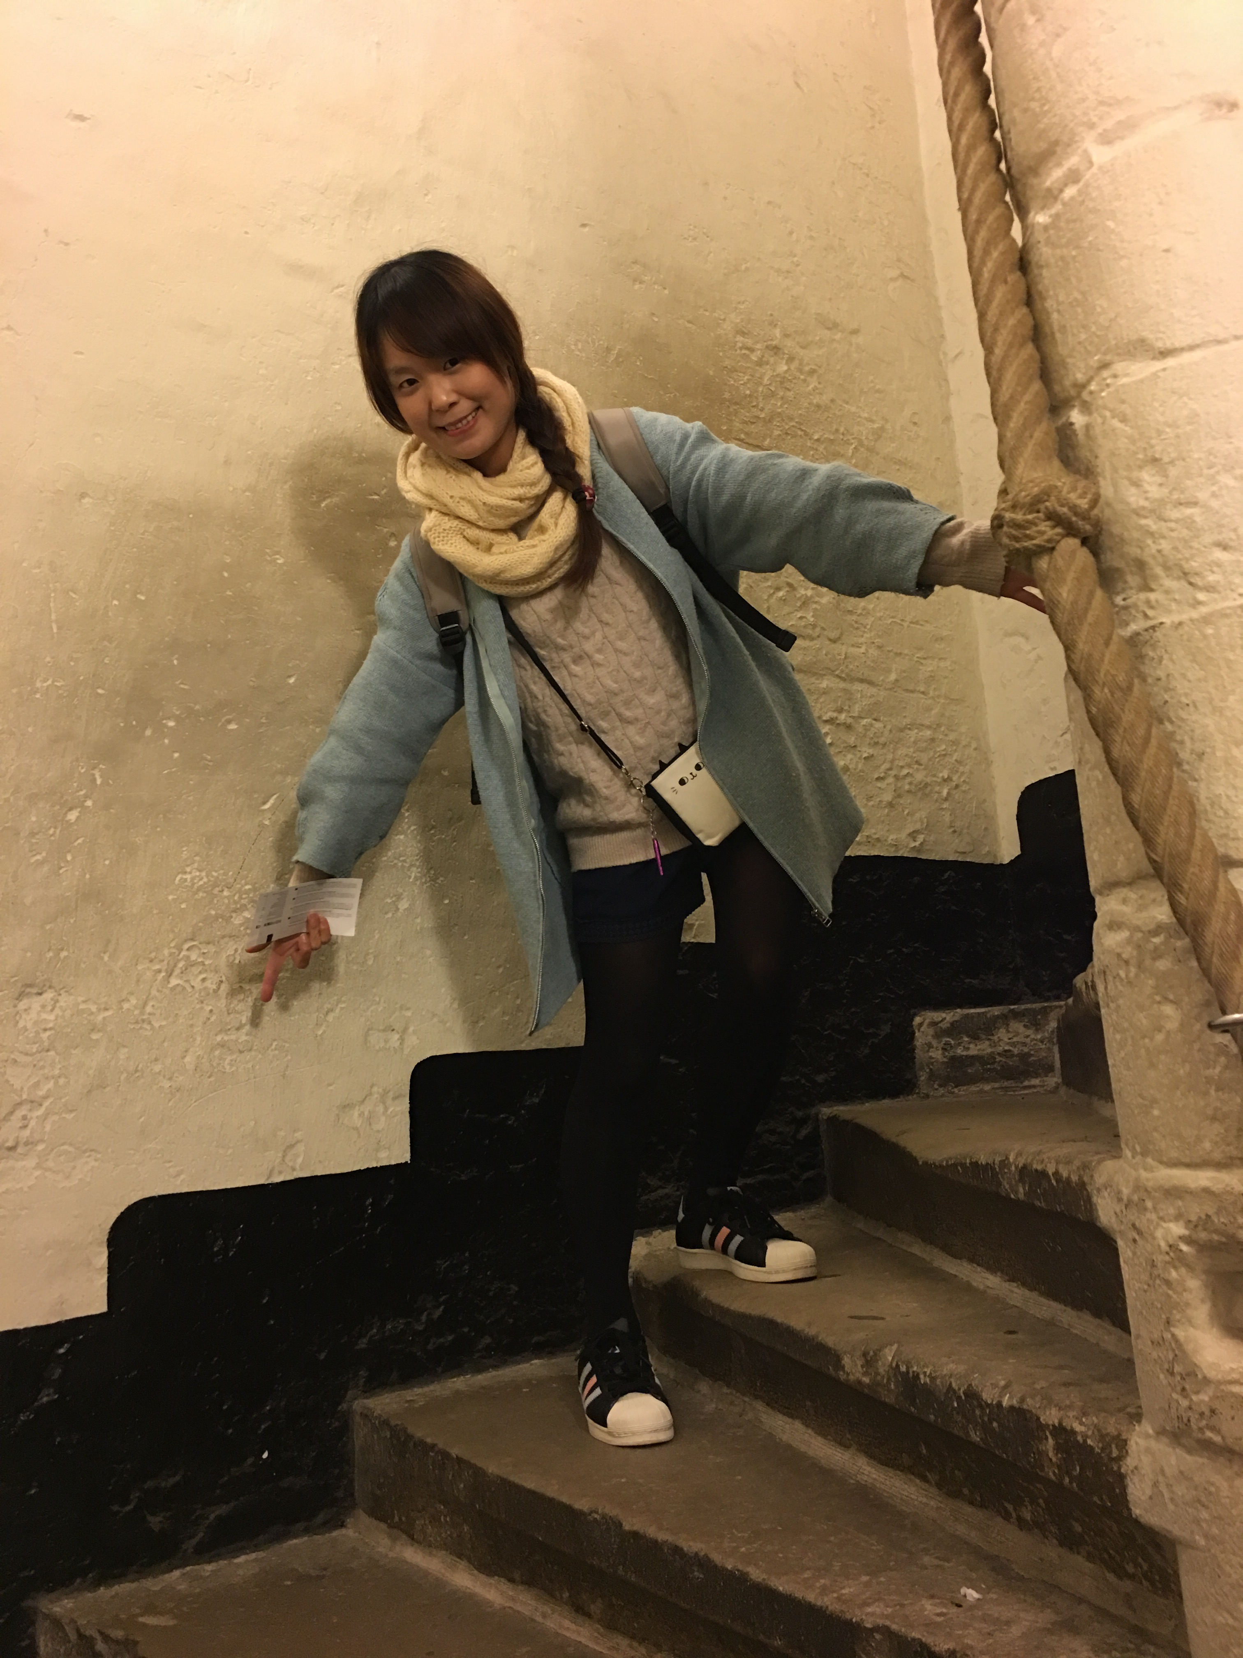
Mandy
is tired.

Slide 14
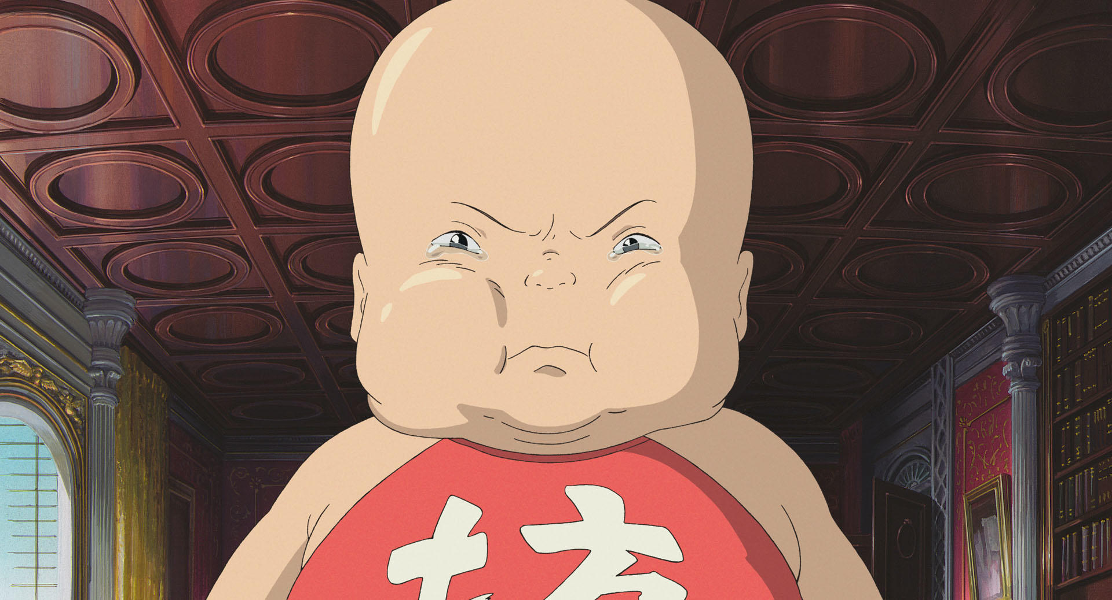
Is he sad?
Yes, he is.
No, he isn’t.

Slide 15
angry
mad
piss off
hit the ceiling

Slide 16
happy
glad
joyful
over the moon

Slide 17
sad
down
blue
in a bad mood

Slide 18
hungry
starving
I could eat a horse.

Slide 19
thirsty
parched
I’m drier than the desert.

Slide 20
sick
have a cold
I'm not feeling well.

Slide 21
tired
sleepy
feel dog-tired

Slide 22
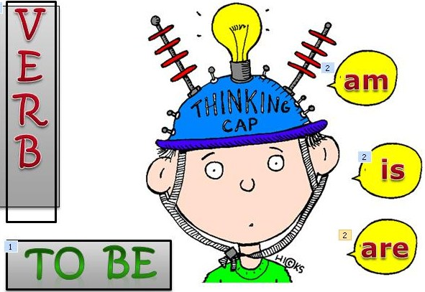
+
am
I
+
is
He
She
It
Mandy
+
are
We
You
They

Slide 23
Are you angry?
Yes, I am.
Yes簡答不能再縮寫，因為已經夠簡短了

Slide 24
Are you angry?
No, I’m not.
I’m happy.

Slide 25
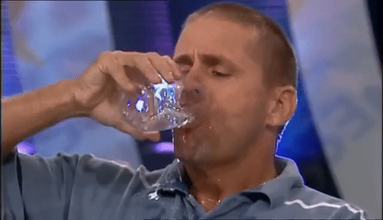
Is he thirsty?
Yes, he is.

Slide 26
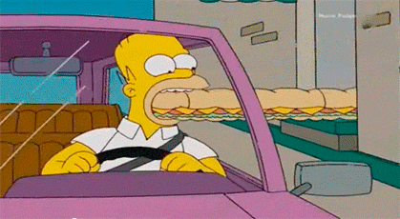
Is he thirsty?
No, he isn’t.
He’s hungry.

Slide 27
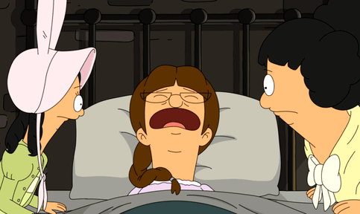
Is she sick?
Yes, she is.

Slide 28
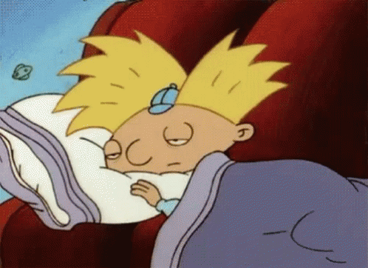
Is she sick?
Yes, she is.
She’s sick and tired.

Slide 29
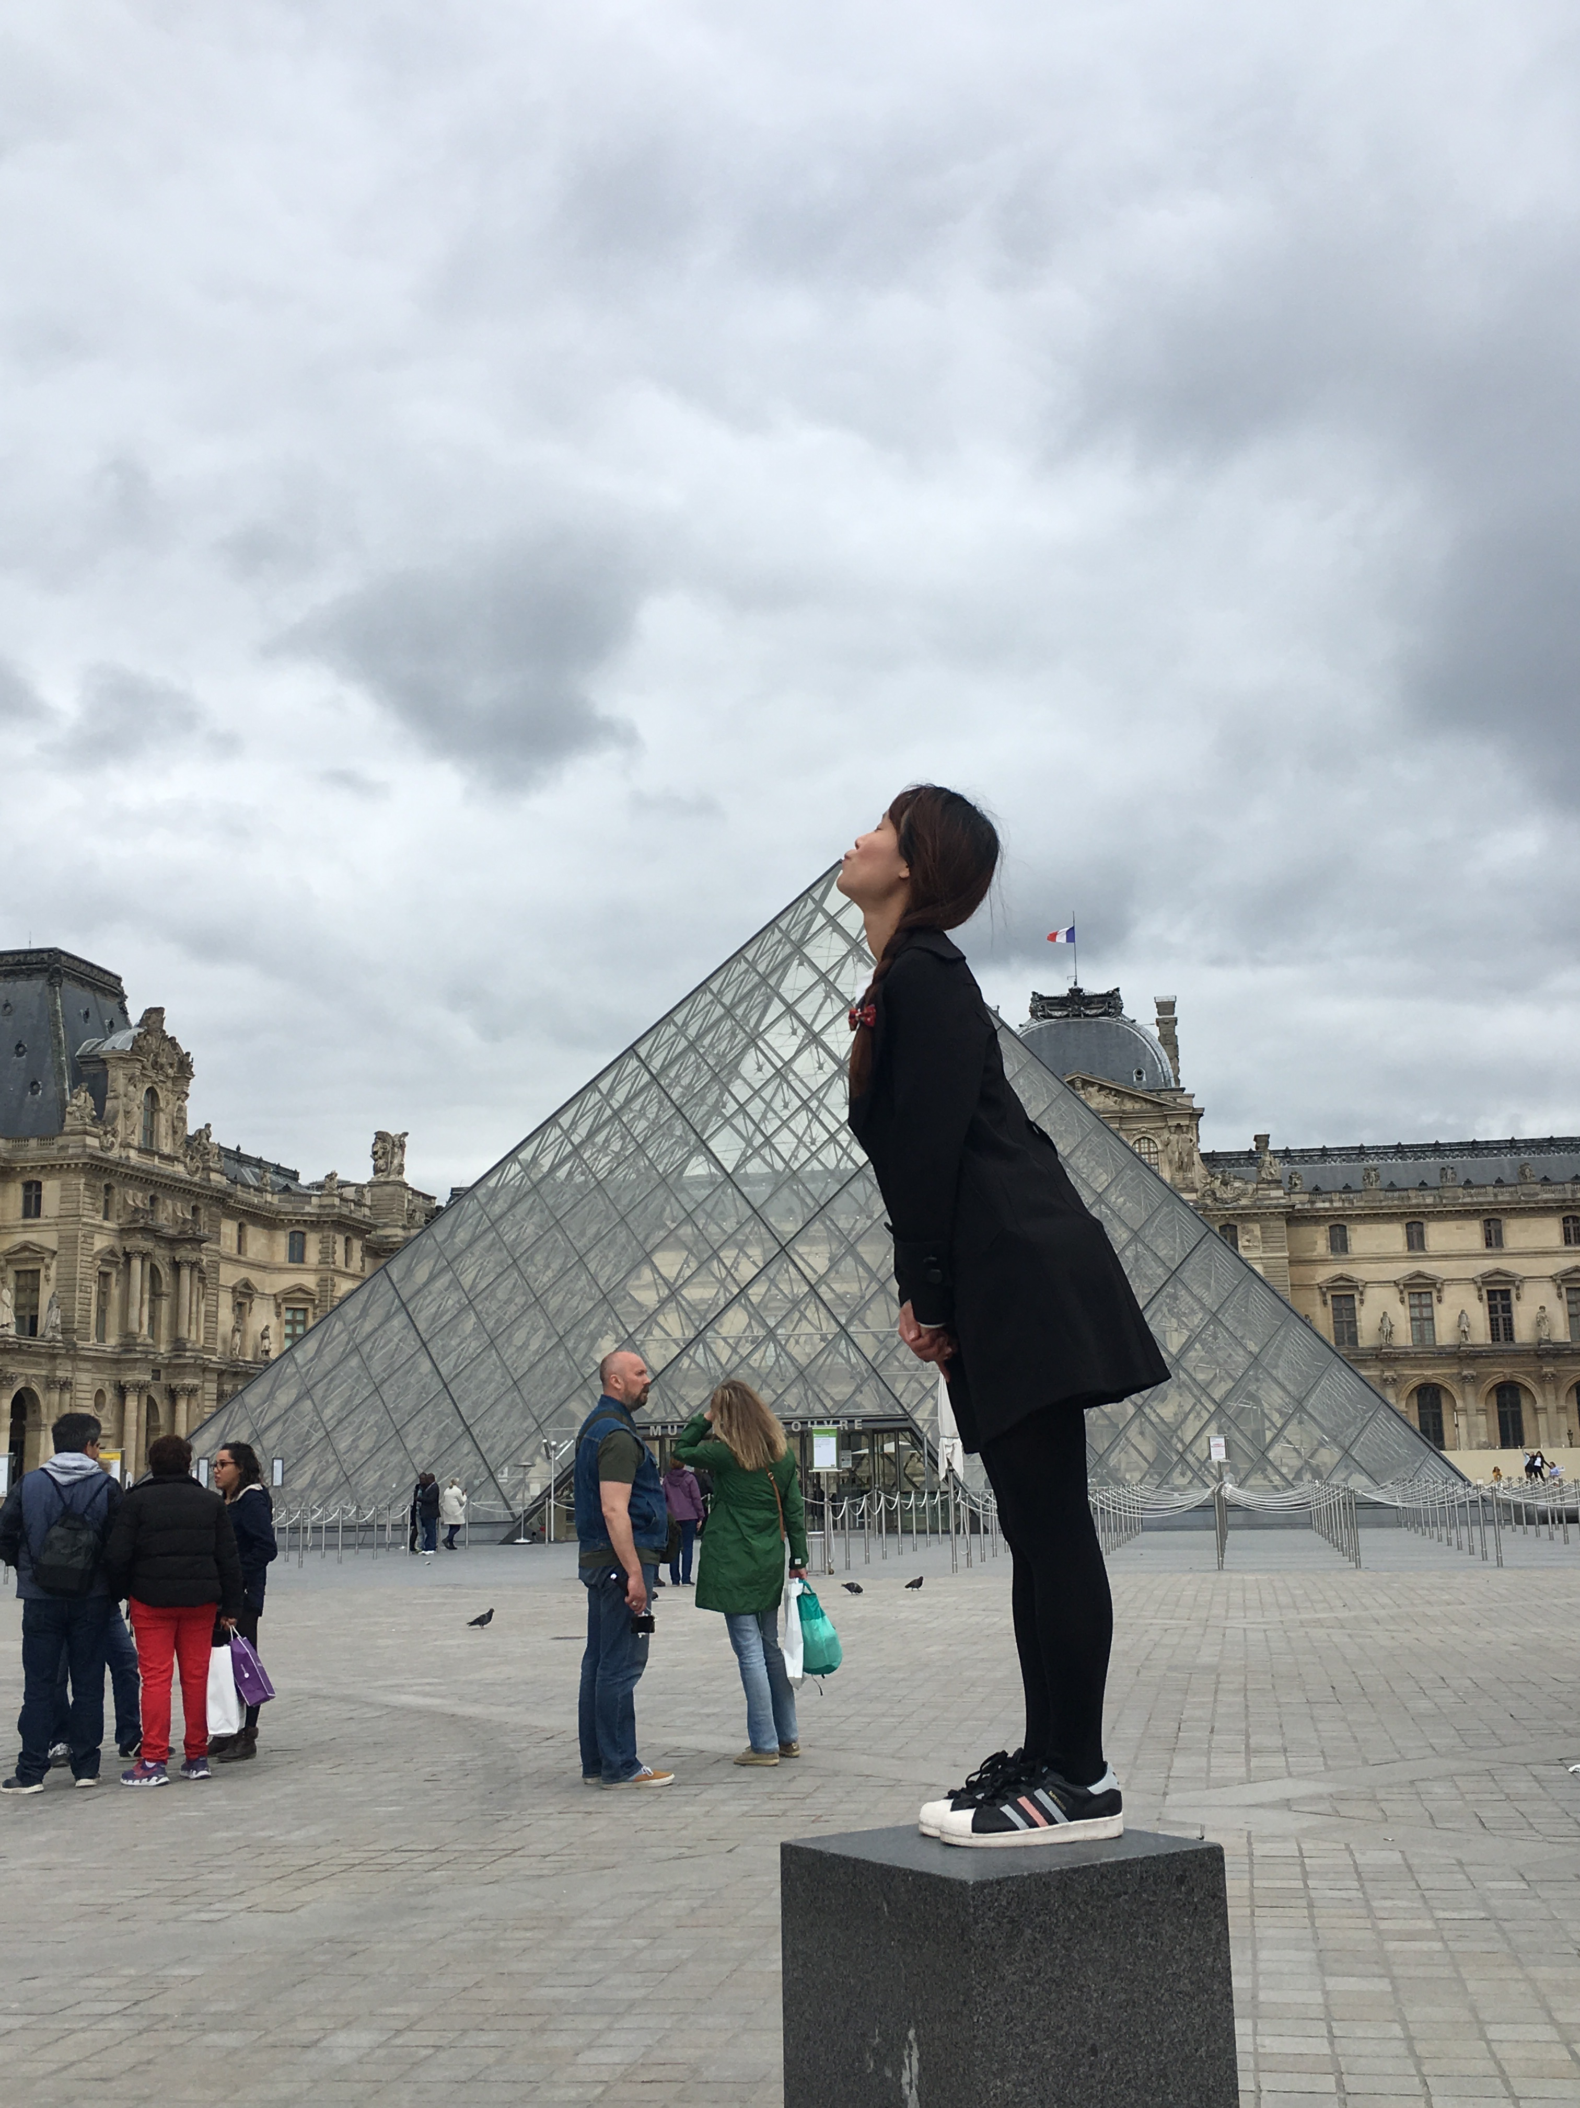
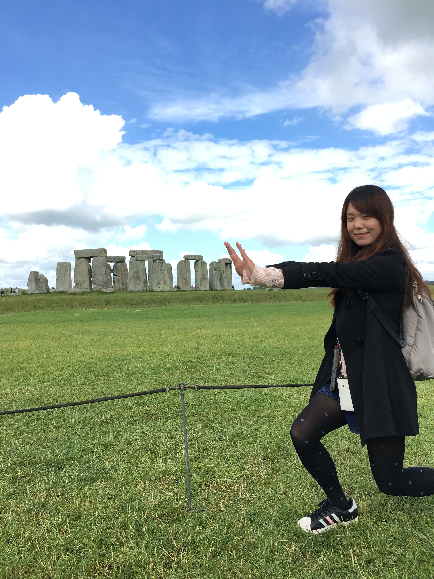
Is Mandy tired?
No, she isn’t.
She’s happy and naughty.

Slide 30
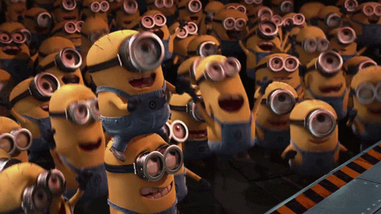
Are they happy?
Yes, they are.
They’re happy
and excited.

Slide 31
Are they happy?
No, they aren’t.
They’re sad
and frustrated.

Slide 34
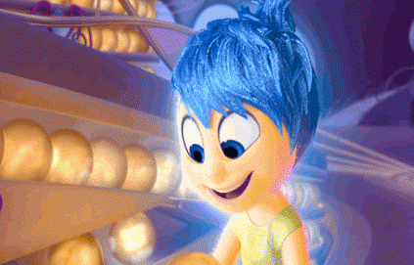
Unit 1 Quiz
Class: No: Name:
1
2
3
5
6
7
4

Slide 35
Draw a simple picture and
make sentences (一問句一答句).
Draw a simple picture and make sentences.
I
you
he
she
it
we
they
am
is
are

Slide 37
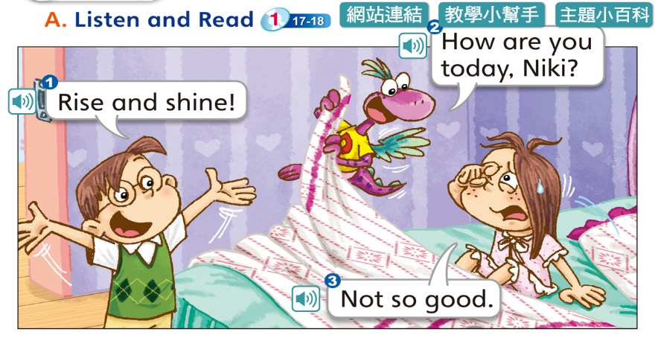
Wake up! /
Get out of bed!
太陽曬屁股囉!

Slide 41
T-rex暴龍
Look out! /
Be careful!
小心!注意!

Slide 42
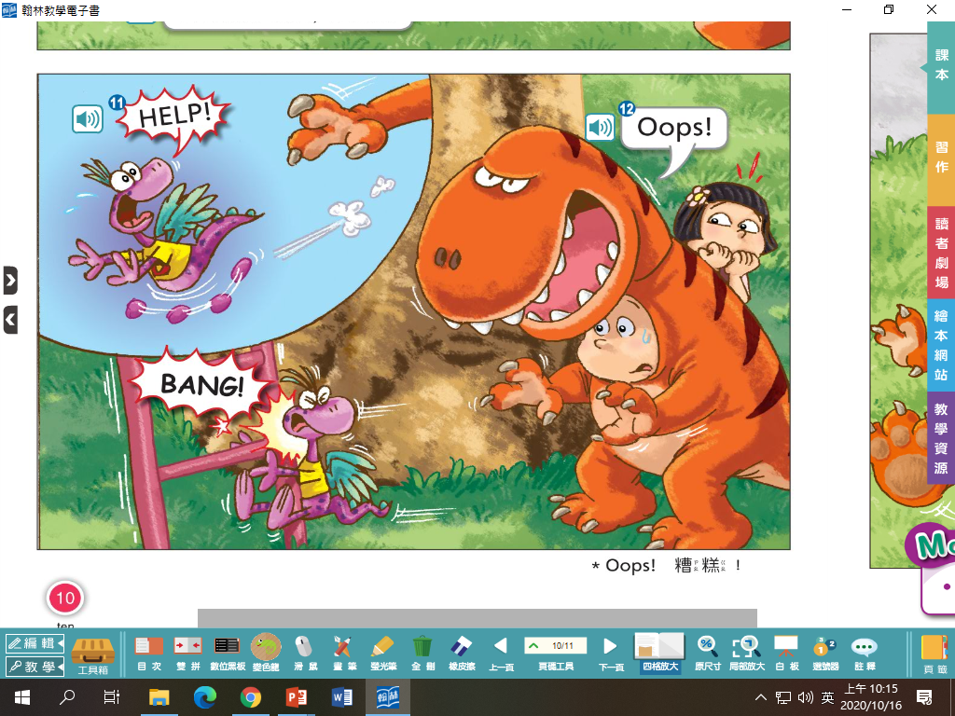
SOS國際救難信號
加強語氣使用大寫字母

Slide 45
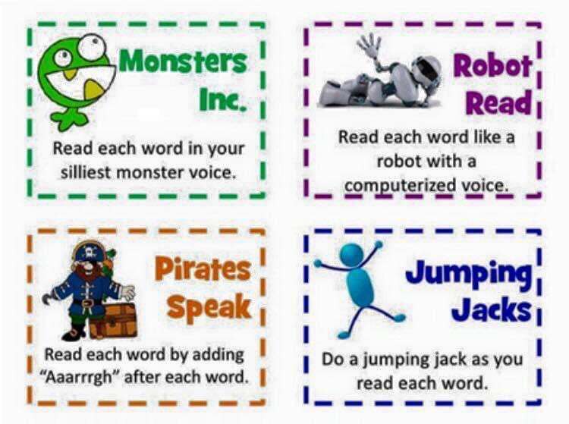

Slide 46
Daily Talk
Watch out!

Slide 47
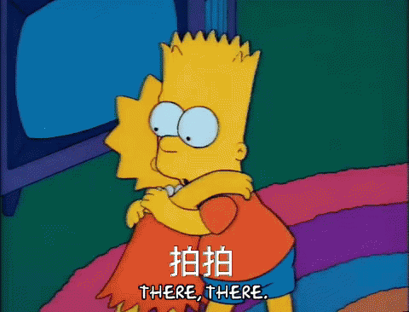
Daily Talk
Are you OK?

Slide 48
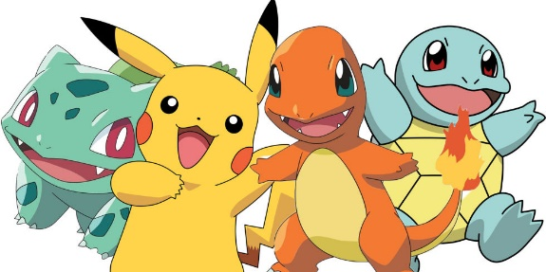
Homework this week
聽: CD1第39-43首。
說&讀:聽CD時跟著大聲唸。完成3遍
請家長在課本P23簽名可換印章。
寫: 完成英語練習簿Unit 2單字，每個4遍
，下週一交。
10/27(二)全校英語日+Halloween活動，
不需特別裝扮，只要盡情開口講英文喔!

Slide 49
P18~P19

Slide 50
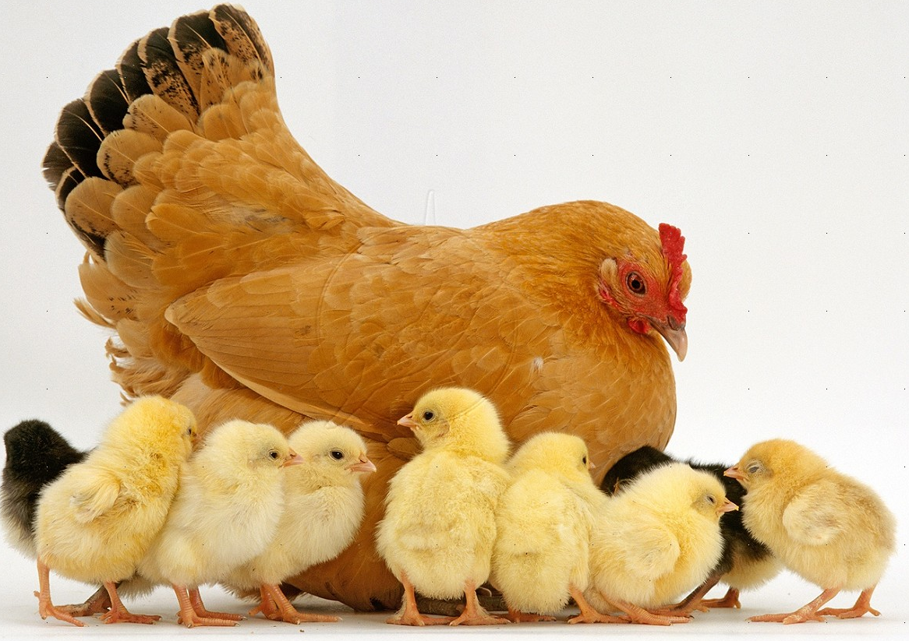
h
en

Slide 51
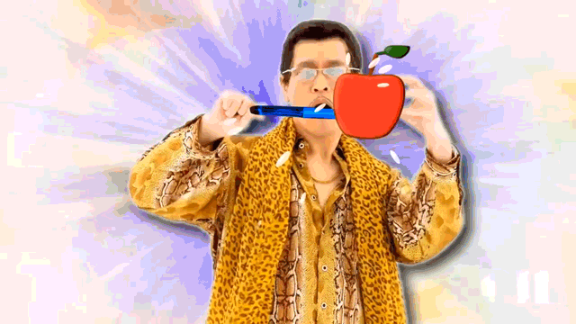
p
en

Slide 52
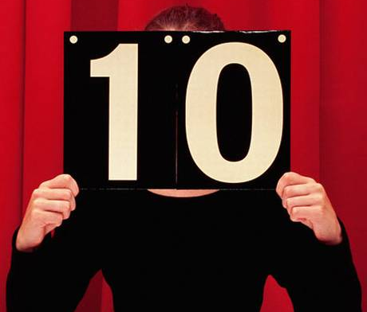
t
en

Slide 53
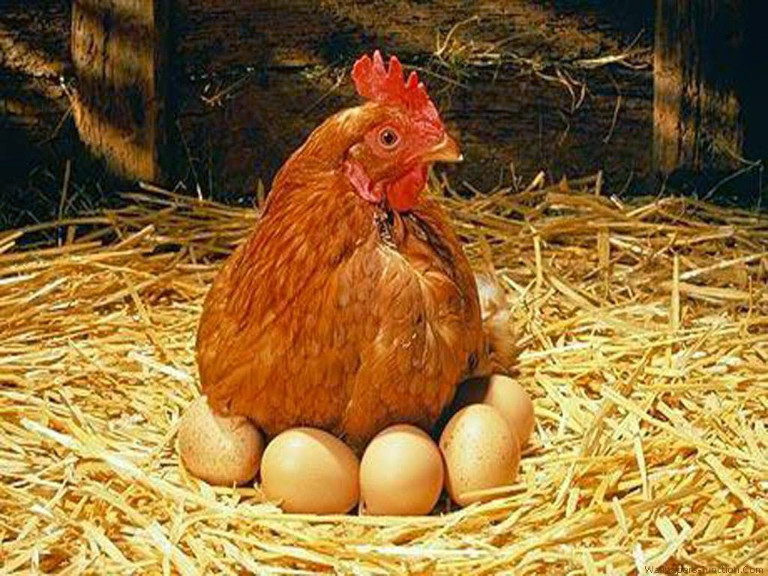
This is a hen.

Slide 54
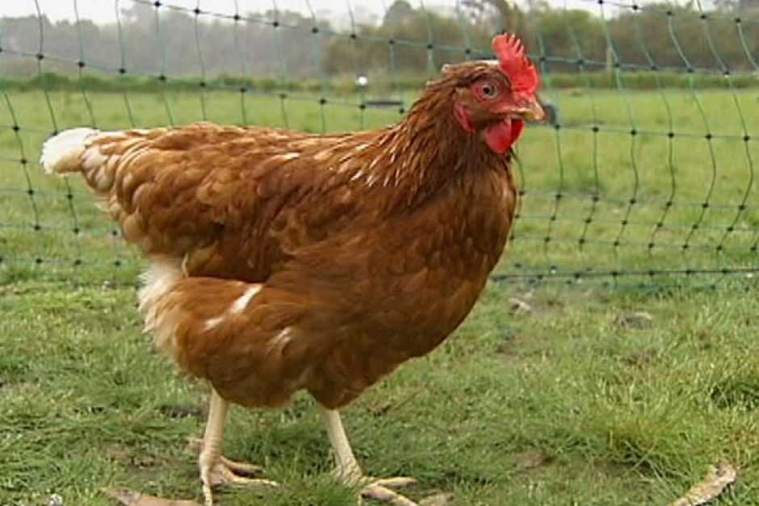
The hen has a pen.

Slide 55
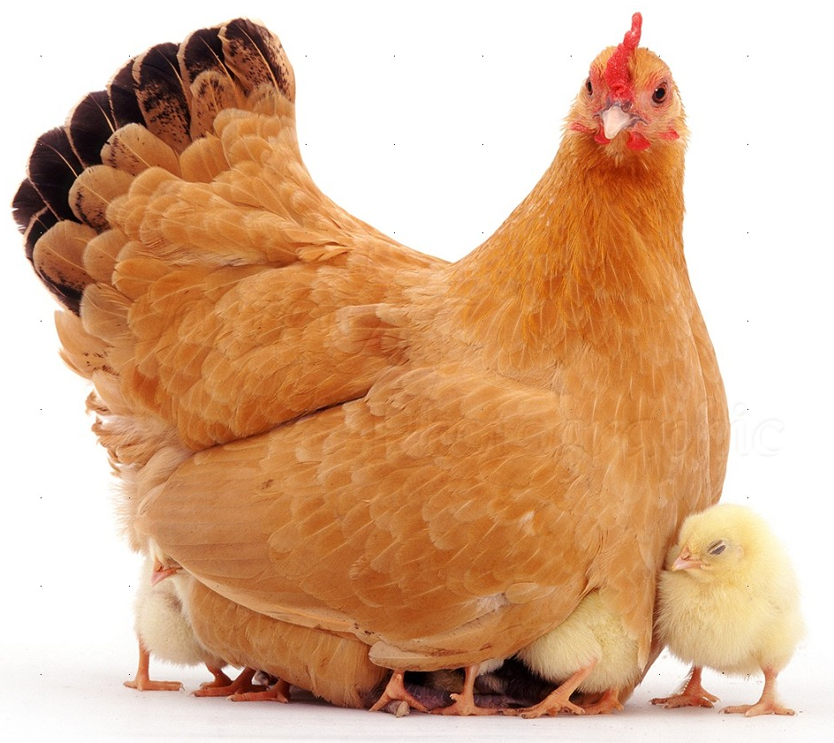
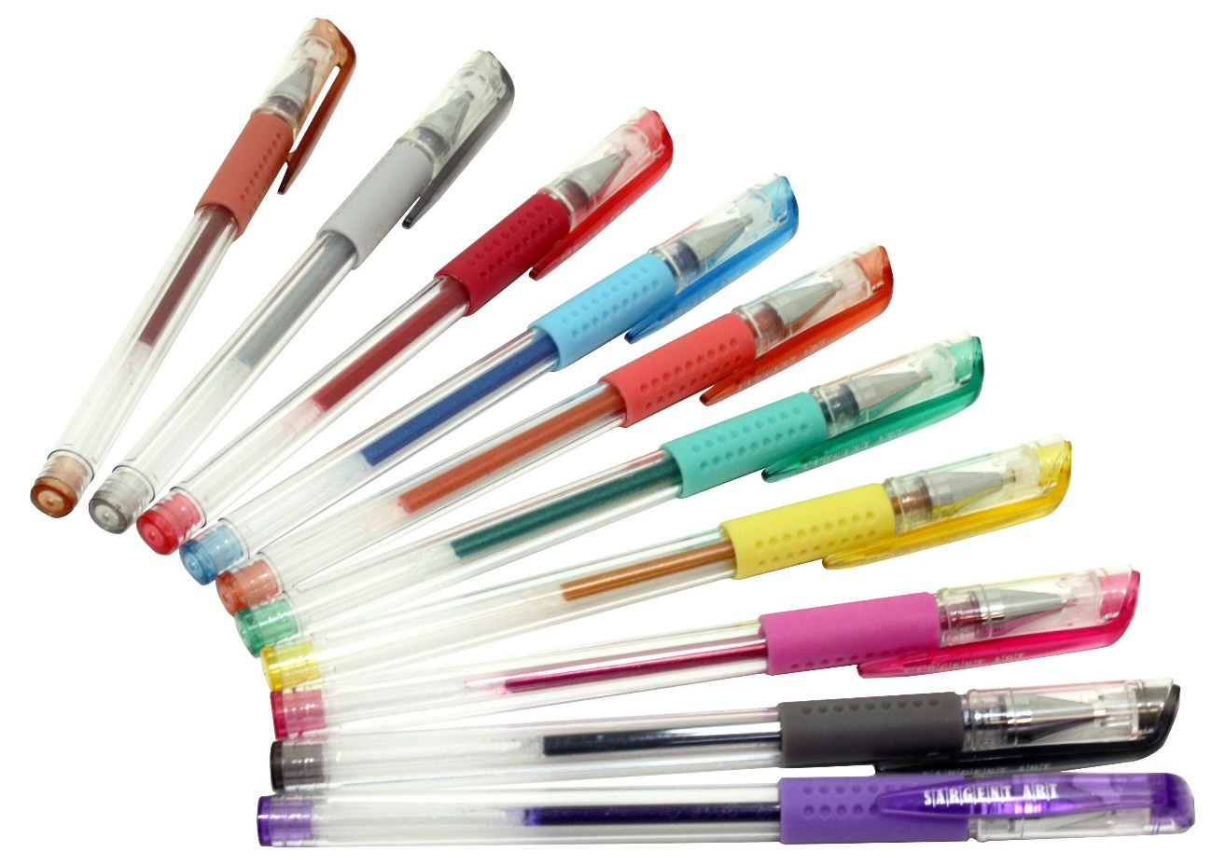
Oh! The hen has ten pens.

Slide 56
b
ell

Slide 57
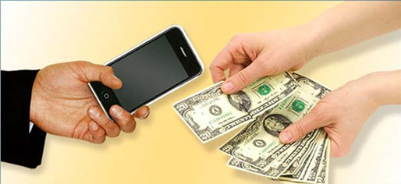
s
ell

Slide 58
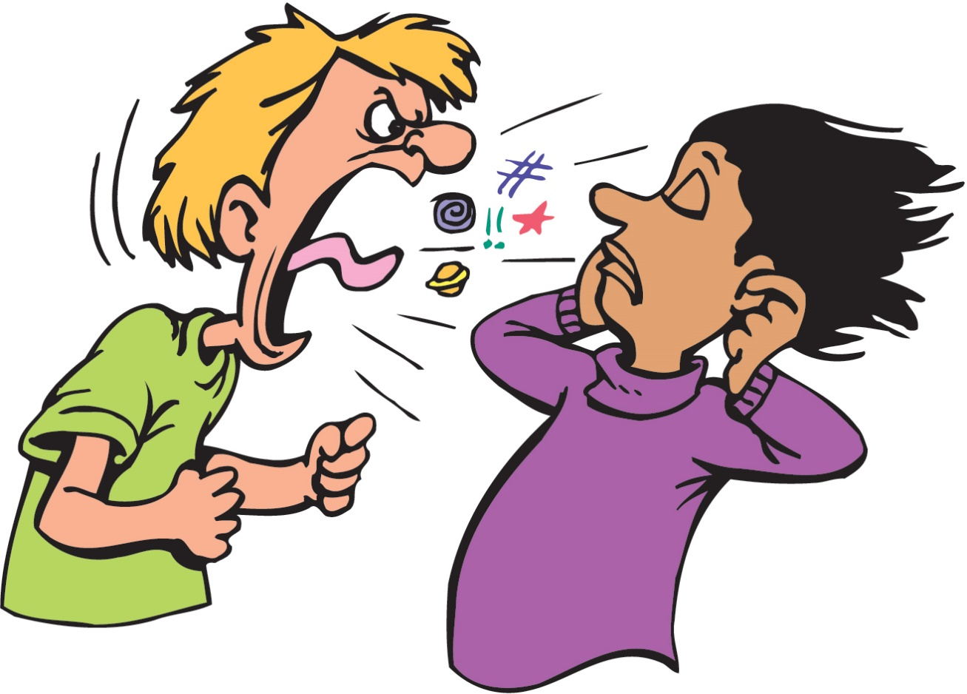
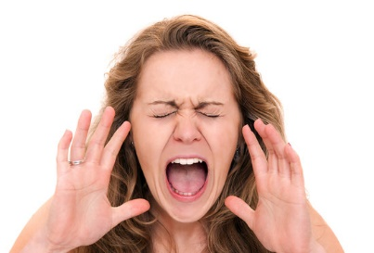
y
ell

Slide 59
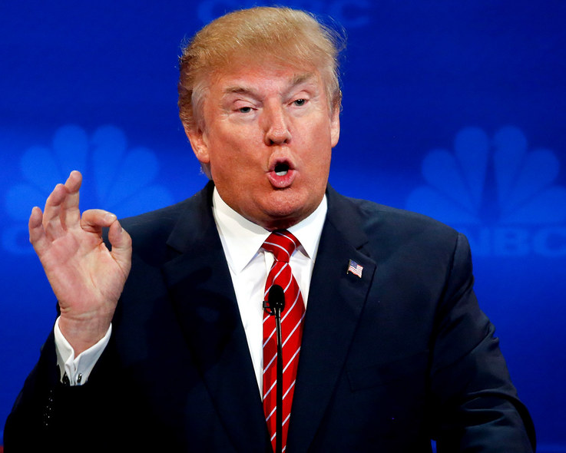
He has a bell.

Slide 60
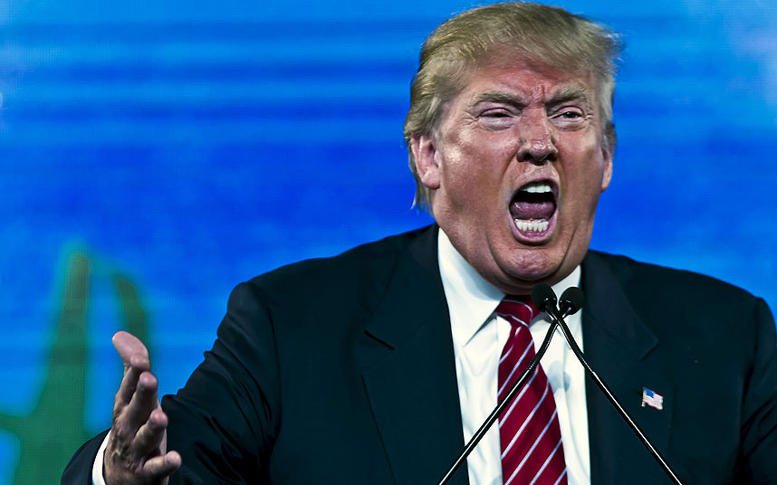
He can yell.

Slide 61
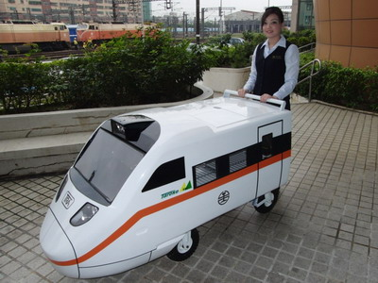
He can yell and sell the bell.

Slide 62
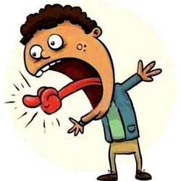
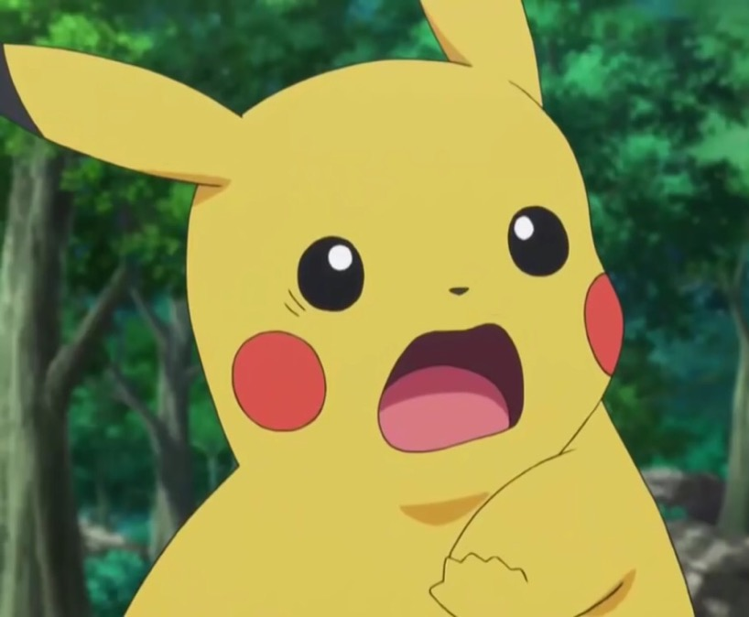
Let’s twist our tongues!!!

